Slide 1

Sustainability Reporting
Seminar 6
Companies that embrace the tenets of good governance, including accountability, transparency and sustainability, are more likely to engender investor confidence and achieve long-term sustainable business performance.
SG Code of Corporate Governance
Notes:
From SG Code of Corporate Governance 2018 (amended 2023) – Introduction
Corporate governance refers to having the appropriate people, processes and structures to direct and manage the business and affairs of the company to enhance long-term shareholder value, whilst taking into account the interests of other stakeholders. Companies that embrace the tenets of good governance, including accountability, transparency and sustainability, are more likely to engender investor confidence and achieve long-term sustainable business performance.
As non-experts in sustainability reporting, the best we can do is to encourage our students to think! Why report, what are the challenges of reporting and what are the benefits. Do the Benefits outweigh the Challenges, in the long-term, YES!
Pre-seminar reading (this is the only thing I ask my students to read. My students also have to read/comment on a Sustainability Report for an SGX company as part of their team project.
https://www.csrwire.com/press_releases/771406-esg-vs-csr-whats-difference-and-why-does-it-matter
For my activities:
I ask students to watch these clips as part of preparing for the class.
https://youtu.be/e7S8jWh6AEs The Paradox of Value
https://youtu.be/PZjIyeIUCzI Proven Benefits of Sustainability Reporting

Slide 2

Sustainability Reporting
Seminar 6
Key takeaways from today
Outline the basic components of a Sustainability Report
Recognise the challenges and benefits of sustainability reporting
Identify sustainability as a core business value
Notes:
These are my learning outcomes for Sustainability Reporting (SR)
I have also included “reading” and “commenting on” (basic understanding and thinking processes, not analysing) in my Team Project (hence the graphic for TEAM).

Slide 3

Any questions about Seminar 5?
Inventory will definitely feature in Quiz #2 and the Final Exam

Slide 4

Sustainability https://youtu.be/iTrvMIEgsZw
Notes:
This is an old clip from McCombs School of Business at Texas University – it is a short and simple intro video about sustainability. The video mentions CSR, and later sides show how CSR is now replaced by ESG. Although in our syllabus, we do not test ethics directly (although complying with the accounting standards and the Companies Act is a form of ethical compliance, this video is ethics-focused).
Main website: https://ethicsunwrapped.utexas.edu/

Slide 5
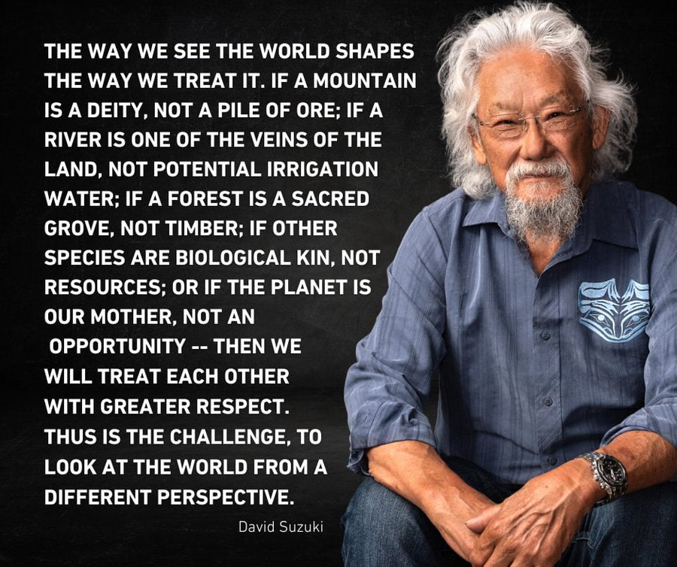
Notes:
https://www.britannica.com/biography/David-Suzuki
I enjoy Prof Suzuki’s approach to teaching and his love of nature. As he is an older Asian, I find he has a closer link to my students than a Caucasian female like me.

Slide 6

Ignoring sustainability is irreversible
https://youtu.be/bsd1IT7ySfE
Notes:
https://youtu.be/bsd1IT7ySfE
This clip from Prof Suzuki gets students thinking about the finiteness of earth and why caring about sustainable living and actually doing something about it is now critical.
SR forces companies to examine their operations and determine if they are truly sustainable in the broader sense rather than just relentlessly chasing profits and espousing to be green.

Slide 7




The world is changing – but ethics is still the bedrock
Balance Shift
Changes in demographics, the growth of new economies and new markets, the shift in economic power from West to East and North to South
Connectivity
New ways of sharing and accessing information, bringing people together, increasing scrutiny and threatening privacy, demanding responsivity and transparency
Changing Values
People’s values and expectations have changed, companies now must have a social purpose
Resource Scarcity
Pressure on the availability and affordability of resources, ranging from food to precious metals to energy

Slide 8

CSR, ESG or ESD …
CSR
  Corporate Social Responsibility
  Precursor to ESG
ESG
  Environment, Social & Governance
  The reporting environment
ESD
  Education for Sustainable Development
  Skilling future leaders
ESD is a lifelong learning process and an integral part of quality education. It enhances the cognitive, socio-emotional and behavioural dimensions of learning and encompasses learning content and outcomes, pedagogy and the learning environment itself. (UNESCO)
Notes:
Previously referred to as CSR, but now we use ESG. There is also literature regarding ESD, which is just the educational side of ESG.
Some literature states that CSR and ESG are complementary, while much of the newer literature shows that ESG replaces CSR and that the S in ESG incorporates CSR.
https://www.csrwire.com/press_releases/771406-esg-vs-csr-whats-difference-and-why-does-it-matter
This is a good article to help students understand the difference between CSR and ESG – I use this as pre-seminar reading.
The background to this slide is from Beyond Thunderdome – Mad Max – this is what the world could look like if we do not take climate change seriously.

Slide 9
Environment, Social and Governance factors (ESG)
CSR – often a disconnected department with limited resources
  CSR allowed bold marketing claims without acting on promises made – effectively facilitating greenwashing
ESG – fully integrated strategic objective (core value)
  ESG – measured, quantifiable and criteria-led metrics
    Reports how a company is working to improve, holistically (not profit driven)
    Indicates future expectations
    Double materiality
SGX (reporting controller)
  Was comply or explain, now transitioning to mandatory
  Climate and diversity deemed material ESG factors and mandatory to report
Notes:
ACRA (6 July) is now seeking views about making larger unlisted Companies to mandatory report on Climate issues.
https://www.acra.gov.sg/news-events/news-details/id/736
The evolving reporting landscape is why it is almost impossible for ACCT101 instructors to provide specific SR instruction as the reporting environment is in flux. The best we can do, as non-experts in SR is to encourage our students to think!

Slide 10









E
SGX – meet regulation, do good, sustain business
Report both the
+ve
and the
-ve
Environmental
Climate change, effluents and waste, clean
energy, energy consumption, carbon emissions,
biodiversity degradation, water, etc.
S
Social
Sustainability
Diversity, human rights, everyone’s health & safety, child & enforced labour, product responsibility, anti-corruption, etc.
G
Governance
Management structure, employee relations,
executive compensation, Board diversity, ethical culture
+ Board and management competence
https://www.sgx.com/regulation/sustainability-reporting
Notes:
In addition to signing up to the UN’s Sustainable Development Goals, Singapore requires all SGX listed companies to publish a Sustainability Report annually, regardless of whether they are Mainboard or Catalist.
SR refers to the public disclosure of a company's practices in environmental, social and governance, or ESG areas. Annual sustainability reporting became mandatory on a "comply or explain" basis for companies on the Singapore Exchange in June 2016. However, SGX has moved to a compulsory sustainability reporting regime as of 2023.
SR complements the financial reporting of listed issuers. Statements of financial position and comprehensive income provide a snapshot of the present and an account of the past year, while sustainability reports of ESG factors show the risks and opportunities within sight, managed for future returns. Taken together, the combined financial and sustainability reports enable a better assessment of the issuer’s financial prospects and quality of management. Decision-usefulness for users of GPFS.
With the effects of climate change becoming increasingly pronounced, the call globally for efforts to combat climate change has grown exponentially and with a new urgency. SGX has introduced a phased approach to mandatory climate reporting based on the recommendations of the Task Force on Climate-related Financial Disclosures (TCFD)
See the link below for more details.
https://www.sgx.com/regulation/sustainability-reporting

Slide 11
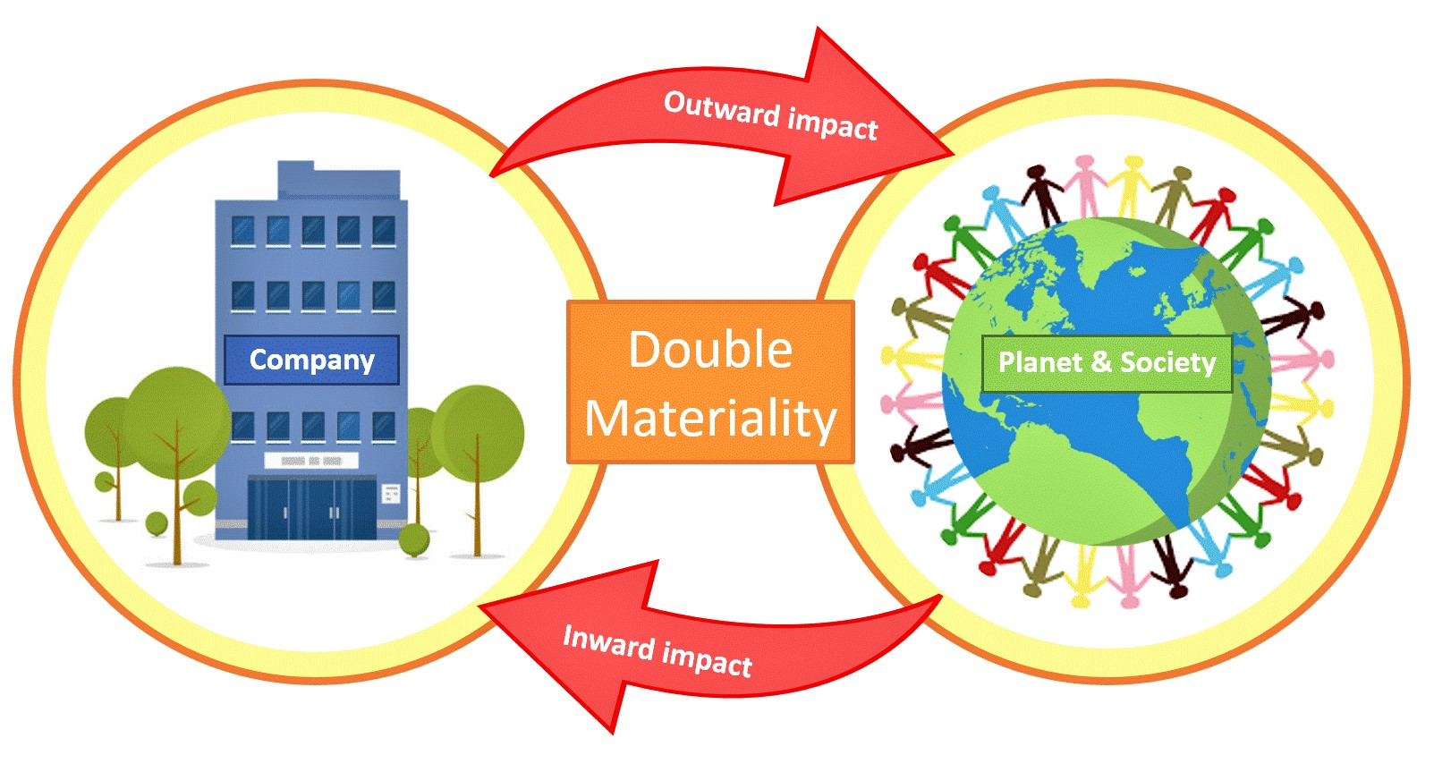
Double materiality https://contextsustainability.com/double-materiality-guide/
For instance, GRI
For SGX, TCFD
Notes:
https://www.acra.gov.sg/news-events/news-details/id/736
Taken from the Straits Times, originally published by Bloomberg
https://www.straitstimes.com/business/invest/what-new-esg-approach-double-materiality-means-and-why-jpmorgan-is-a-fan
1. What is materiality?
At the basic level, it is an accounting principle, referring to something that may have an impact on – be material to – how a company performs.
A material risk can threaten targets or goals – something of keen interest to investors. In the context of ESG, this is known as single materiality and means mainly ESG factors that may pose a threat or opportunity to a business and its bottom line, such as extreme weather. It does not tell you anything about how “green” a company’s business practices are, but rather how vulnerable its earnings may be to ESG risks.
2. What is ‘double materiality’?
That is where greenness comes in. “Double materiality” adds the risks a company’s activities pose to the environment and society to those that it potentially faces internally. How such things should be accounted for in corporate reports remains the subject of intense debate. For now, reports vary wildly, making it hard for investors to compare one company or fund with another and make informed decisions.

Slide 12
Information is material if …
omitting, misstating or obscuring it could reasonably be expected to influence decisions that primary users of general purpose financial sustainability reports make on the basis of those reports.
Therefore, materiality is entity-specific based on the nature and/or magnitude of the items to which the information relates in the context of the company’s sustainability report.
Consequently, “we” cannot specify a uniform quantitative threshold for materiality or predetermine what could be material in a particular situation. (adapted from SFRS(I) conceptual framework)

Slide 13


Determining and communicating material topics
Apply the four steps to determine material topics
Assess impacts & prioritise
Stakeholder Engagement
For each topic, disclose approach, target & performance
Disclose the list of material topics & boundary (scope)
Disclose the process to determine material topics
For a company, who are its stakeholders?
Notes:
From this slide, Stakeholder Engagement is critical – the material ESG factors are not what the company determines, but what the Stakeholders want the company to report on. This is a time-consuming and costly process but be appropriately carried out if the company is to report correctly.

Slide 14



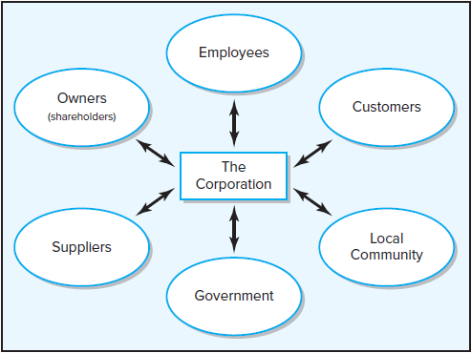
Good corporate citizenship
Guided by strong moral and ethical standards in daily interactions with all stakeholders
Carefully balances shareholders’ needs with the needs of
other stakeholders
Constantly considers the environmental impact of its business operations
ENVIRONMENT
Media
Competitors
Supply Chain
T & I Assoc.
Unions
Social & Political Action Groups
Notes:
Whenever we think about stakeholders, we should always think about the past, present and the future. Sometimes our actions take a long time for the negative effects to appear. Thinking about the past helps us identify trigger points for unethical behaviour and provides guidance on how we might prevent such actions happening again as well as to help us rectify the problems.

Slide 15

Primary Components of a Sustainability Report
Material ESG Factors
Polices, Practices & Performance
Targets
Sustainability Reporting Framework
Board Statement
Climate-related Disclosures (TCFD)
Notes:
This slide gives an overview of the primary components of the sustainability report as required by the Singapore Exchange rulebook. As this is an important part of this introduction to SR, instructors should spend time to explain each component.
(a) Material ESG factors. The sustainability report should identify the material ESG factors, and describe both the reasons for and the process of selection, taking into consideration their relevance or impact to the business, strategy, financial planning, business model and key stakeholders.
(b) Climate-related disclosures. The sustainability report should contain disclosures related to climate risks and opportunities, consistent with the TCFD recommendations.
(c) Policies, practices and performance. The sustainability report should set out the issuer's policies, practices and performance in relation to the material ESG factors identified, providing descriptive and quantitative information on each of the identified material ESG factors for the reporting period. Performance should be described in the context of previously disclosed targets.
(d) Targets. The sustainability report should set out the issuer's targets for the forthcoming year in relation to each material ESG factor identified. Targets should be considered for defined short, medium and long term horizons, and if not consistent with those used for strategic planning and financial reporting, the reasons for the inconsistency should be disclosed.
(e) Sustainability reporting framework. The issuer should select a sustainability reporting framework (or frameworks) to guide its reporting and disclosure. For climate-related disclosures, the issuer should report based on the TCFD recommendations. The sustainability reporting framework(s) selected should be appropriate for and suited to its industry and business model. The issuer should state the name of the framework(s), explain its reasons for choosing the framework(s) and provide a general description of the extent of the issuer's application of the framework(s).
(f) Board statement. The sustainability report should contain a statement of the Board that it has considered sustainability issues in the issuer’s business and strategy, determined the material ESG factors and overseen the management and monitoring of the material ESG factors. In addition, the sustainability report should describe the roles of the Board and the management in the governance of sustainability issues.
From https://rulebook.sgx.com/rulebook/practice-note-76-sustainability-reporting-guide

Slide 16






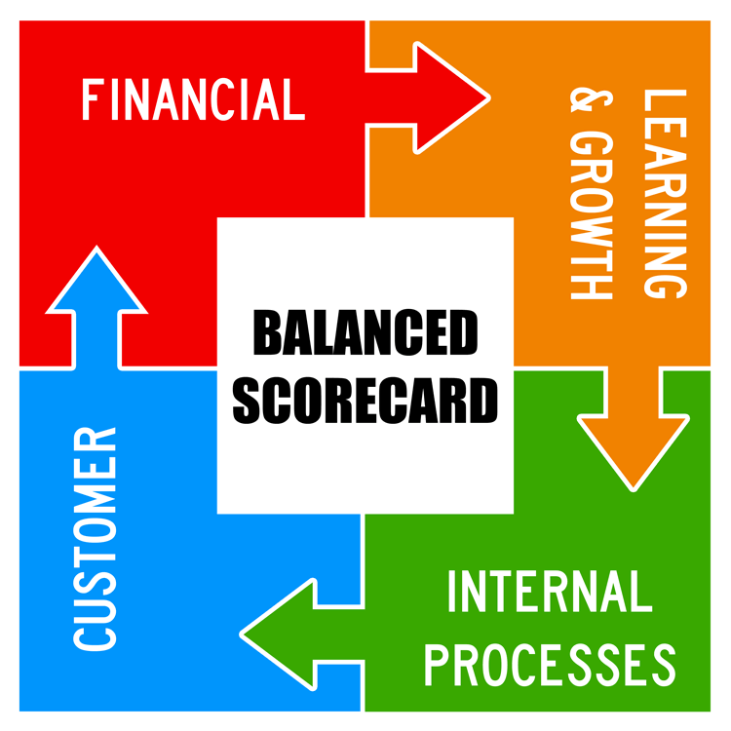
Major Reporting Frameworks
The framework selected must be what the stakeholders want, not just what the company wants or what is easy.
Notes:
There are no less than a dozen reporting frameworks available to guide entities in sustainability reporting and disclosures. Here, we introduce some major frameworks with the largest adoption rates. Frameworks provide principles-based guidance on how information is structured, how it is prepared, and what broad topics are covered. Meanwhile, standards provide specific, detailed, and replicable requirements for what should be reported for each topic, including metrics. Entities may select components within different frameworks to best apply and report to their selected audience.
Sustainability reporting framework
4.30 The issuer should select a SR framework which is appropriate for and suited to its industry and business model, and explain its choice. In doing so, the issuer should place importance on using a globally-recognised framework for its wider acceptance in an increasingly global marketplace. The issuer can be more easily understood and compared with its peers in Singapore as well as in other jurisdictions across the world. The issuer should exercise considerable caution if it chooses to deviate from generally-accepted frameworks.
4.31 Among the well-known and globally-recognised SR frameworks, the Global Reporting Initiative (“GRI”) SR Guidelines set out generic sustainability factors and general principles and indicators that an issuer can use to report sustainability policies, practices, performance and targets. The International Integrated Reporting Council's (“IIRC”) Framework (“<IR>”) also sets out a general framework for reporting. An issuer using <IR> should consider ESG factors when determining their material factors for inclusion in the integrated report. The issuer may also consider referring to the Sustainability Accounting Standards Board's (“SASB”) standards which adopt an industry-specific approach to material ESG factors. IIRC and SASB have merged to form the Value Reporting Foundation. More than one SR framework may be chosen as relevant to the issuer's business.
4.32 For climate-related disclosures, the issuer should provide such disclosures consistent with the TCFD recommendations. Some issuers have used the Science Based Targets initiative to guide their GHG emissions reduction targets.
Kelly provided a lot more information about each framework, but I think it is better to read what SGX has written to provide an overview for ACCT101.

Slide 17
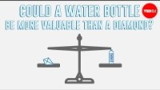
Diamonds or Water
https://youtu.be/e7S8jWh6AEs
Notes:
I ask my students to watch this video prior to coming to class, but you may want to show it during class.
https://youtu.be/e7S8jWh6AEs

Slide 18
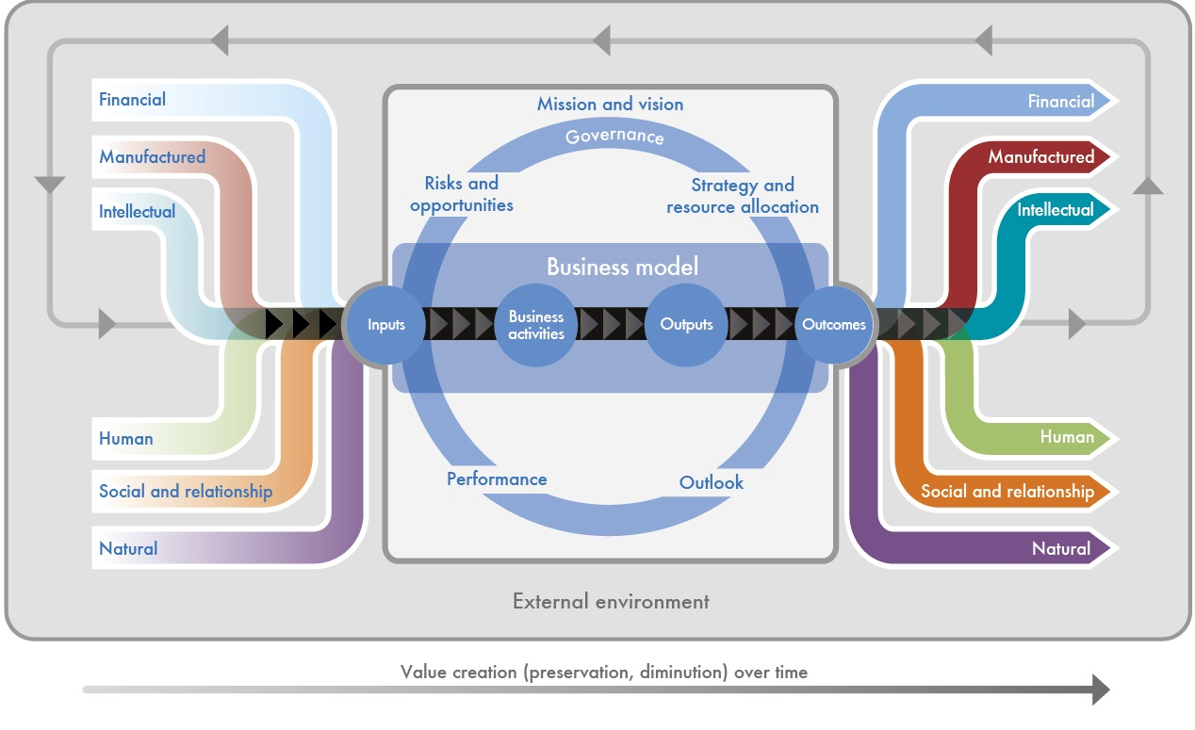
<IR> Value creation
What do you value?
Cultural value
Religious value
Sentimental value
Financial value
Personal value
Economic value
Diamonds or Water
Notes:
So what is value creation?
As students of financial accounting, we have a tendency to think of value in terms of money or numbers first; to measure, either in dollars or in some other units. And we often forget that value is an estimate of the relative importance, worth and or usefulness of the natural capital to people, business and society in a particular context. Therefore, value can be monetary, as in dollars; quantitative, as in units; or qualitative.
When we are measuring the value of something, we need to think about both the negative and positive effects of a business activity on the natural capital. We also need to consider how dependent an organisation is on having access to that natural capital.
While we may arrive at a monetary value, this ‘value’ might exclude everything that you think is valuable because these factors were either too hard to measure or the item or thing did not lend itself to being measured. Sometimes value cannot be monetised or quantified, like happiness, kindness and doing good. It is very difficult to monetise intrinsic worth.
That said, many companies in the past failed to account for the harm that they were causing the environment and others. Hopefully, ESG reporting and embedding ESG factors as core business values will reduce this problem.
I use the following resource in my COR3302 Ethics and Social Responsibility module, but you might find it useful background material for SR. It is much less relevant to our ACCT101 students.
To learn more about how the accounting profession creates value, visit: https://www.ifac.org/knowledge-gateway/preparing-future-ready-professionals/publications/understanding-value-creation

Slide 19
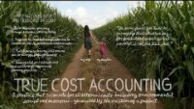
True cost accounting … https://youtu.be/u_Urrn4HiEU
Notes:
https://youtu.be/u_Urrn4HiEU
https://tca2f.org/
True cost account, also called full cost accounting
https://www.eea.europa.eu/help/glossary/eea-glossary/full-cost-accounting
https://tca2f.org/wp-content/uploads/2022/03/TCA_Agrifood_Handbook.pdf
This clip explains the importance of measuring everything, not just financial numbers.

Slide 20
Budget 2022
“Over the coming decade, we expect to see a greening of traditional sectors of our economy, like aviation, energy, and tourism.
At the same time, emerging green sectors like green finance, and carbon services will grow in prominence.
Millions of new green jobs will be created around the world, and demand for talent with green skills will increase.”
Lawrence Wong, Minister for Finance, Singapore
Sustainability reporting is not a disclosure exercise but a whole-of-business responsibility

Slide 21

17 Goals https://youtu.be/cBxN9E5f7pc
Notes:
An introductory clip to the 17 Sustainable Development Goals. The voice-over is by Emma Watson (Hermione Granger from Harry Potter).
https://youtu.be/cBxN9E5f7pc
Here are some other links for Singapore and Asia.
https://www.singstat.gov.sg/find-data/sdg
https://www.aseanstats.org/wp-content/uploads/2022/11/The-2022-ASEAN-SDG-Snapshot-Report-b.pdf

Slide 22

Notes:
These are the goals where SG has done exceptionally well so far, and we are working toward the other goals.

Slide 23
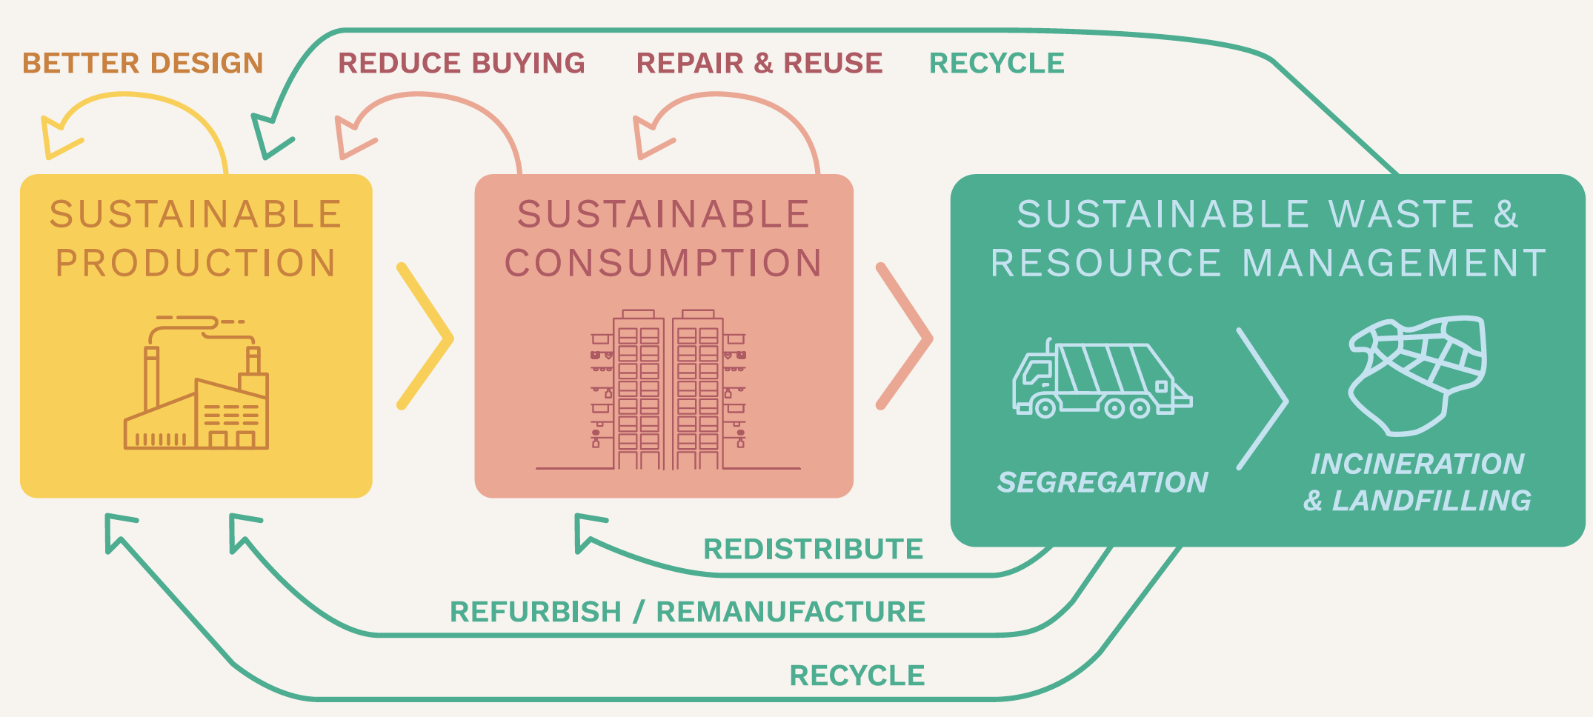
The circular economy and the 3 Rs
Notes:
What is the circular economy
https://www.towardszerowaste.gov.sg/circular-economy/
It is important for students to understand that SR is is not a disclosure exercise but a whole-of-business responsibility. As future business leaders, our students need to see how SR fits into the bigger picture and how they can be exemplary custodians of the circular economy.

Slide 24
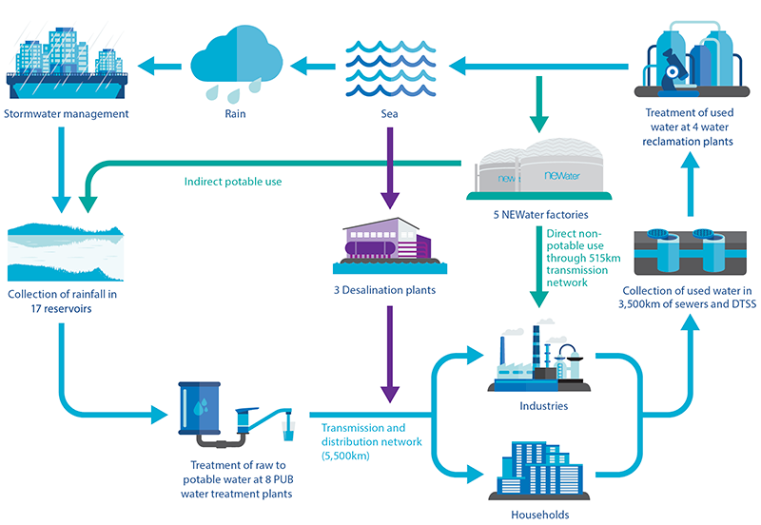
Circular economy – Singapore water
https://www.towardszerowaste.gov.sg/zero-waste-masterplan/chapter2/circular-economy/
Notes:
An example from Singapore
We have also closed the water loop. By combining water and sanitation, Singapore is able to endlessly recycle water, reusing it again and again. Every drop of used water is collected and treated, turning much of it into drinking water again. This has allowed Singapore to reintroduce up to almost 800,000 m3 of ultra-pure recycled water into our system each day. An 50m swimming pool (50m x 30m x 2m) holds about 2,500 m3, so Singapore reintroduces the equivalent of 320 swimming pools of water back into our system each day.
The pay-per-use plastic bag charge is another example from Singapore.
Is the money collected from charging for plastic bags revenue to the supermarket, for instance NTUC?
The government strongly encourages supermarket operators to channel the proceeds from the bag charge to environmental or social causes. Supermarket operators have indicated that they intend to do so.
Obligated supermarket operators are required to publish information annually on the number of disposable carrier bags supplied, amount of proceeds collected, and how the proceeds are used. This will ensure that there is transparency and accountability in their use of proceeds. https://www.nea.gov.sg/our-services/waste-management/disposable-carrier-bag-charge

Slide 26
What are the challenges and benefits of embracing sustainability as a core business value?
For the company as a whole and for its sustainability report
Notes:
Challenges
Lack of standardisation in reporting frameworks
Data availability and quality
Data integration and systems to accurately measure
Materiality assessments (not materiality to the company, but to its stakeholders)
Scope and boundaries of data collection (is there slave labour anywhere in my supply chain, for instance? How am I to know?)
Verification and external assurance
Evolving regulatory landscape and the cost of compliance
Cost of reporting and money spent on reporting could be better spent on doing better ESG things (the quiet achiever)
Profiteering by “experts” – must report, so experts charge super-high fees
Carbon tax costs and quality of carbon credits (carbon scams)
Risk of greenwashing (fraud), even if unintentional
Hiring quality staff with the necessary skillset and retaining these employees
The speed and scope of communication today, mean that a company’s reputation can be undermined instantly with little recourse – green vigilantes
How green is a company expected to be and how quickly must it become green? Green metamorphism does not happen overnight
Benefits
Cannot fix what you do not know exists (benefits of quality data collection)
Competitive advantage
Employer of choice (attract quality staff, less employee turnover, etc.)
Financing options (green financing, government funding, capital markets, etc.)
Less risk of financial penalties (fines, being sued, etc.)
Brand awareness and good reputation
Reduced chance of litigation
Not a target for regulators (risk-based approach)
Increased revenue (repeat customers, customers willing to pay more for the greener option)
Reduced costs (for instance, cheaper financing, lower employee replacement, use less utilities, more efficient, etc.)
Better understanding of opportunities and risks
First mover advantage

Slide 27

Challenges and benefits of sustainability reporting (G7)
Notes:
This and the next two slides are macro-based and function like a whiteboard whilst in presentation mode.
I use one slide per section, and I ask the students to give me a list of the benefits and challenges that they came up with – I can then type the answers in without rolling up the screens.

Slide 28
Challenges and benefits of sustainability reporting (G10)

Slide 29
Challenges and benefits of sustainability reporting (G11)

Slide 30
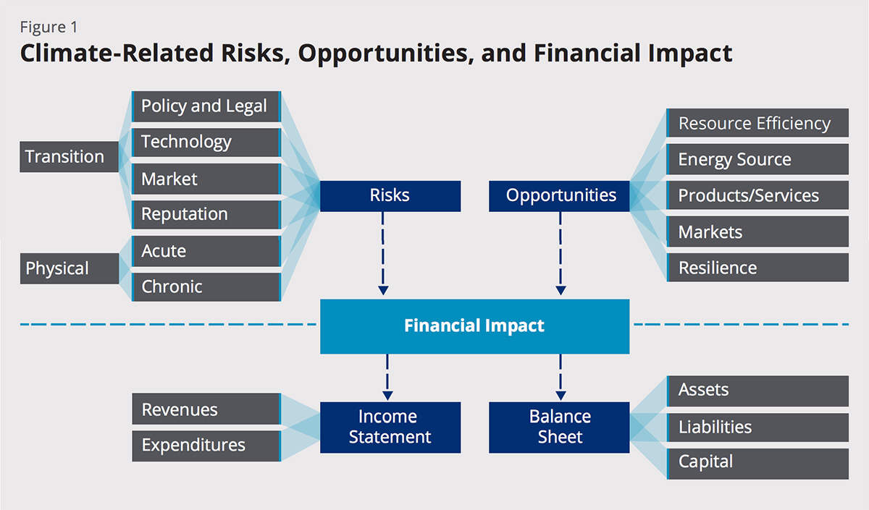
Notes:
This slide summarises the TCFD guidance for companies on how and what to integrate in their financial disclosures related to climate change. The TCFD’s definition of climate risk encompasses both transition and physical risk and recommends companies address climate risk across governance, strategy and risk management, with a set of metrics and targets to show ambition and progress.
The recommendations also encourage companies to consider opportunities to be found in climate-related efforts such as cost savings through improved resource efficiency or supply chain resilience. The Task Force recommends the use of scenario analysis to disclose an organisation’s planning under future scenarios, most notably one with in a 2°C scenario.
https://www.nationalgrid.com/stories/energy-explained/what-are-scope-1-2-3-carbon-emissions
This link provides a quick overview of what Scope 1, Scope 2 and Scope 3 emissions are – this is more for your FYI.
More details on this is in further accounting modules and not required for this module.

Slide 31
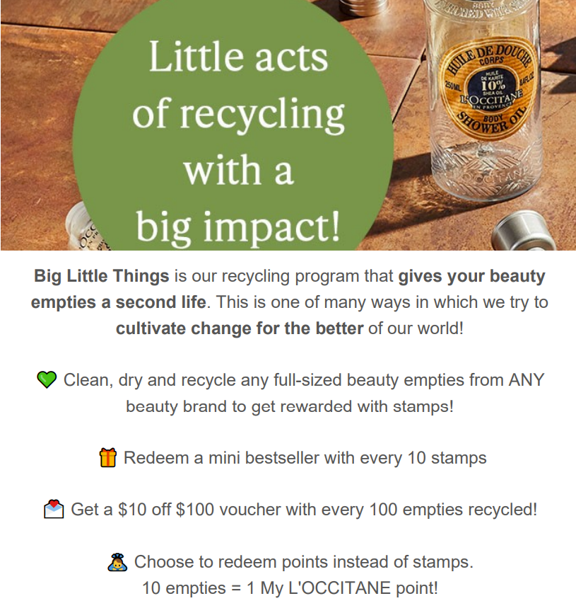
Greenwashing?
Making people believe that your company is doing more to protect the environment than it really is …
BUT, is doing something (even if exaggerated) better than doing nothing at all?
How much must companies change and over what timeframe?
2021: Centre for Governance and Sustainability and SGX found that all listed companies reported favourable (+ve) aspects of ESG achievements but only 66% mentioned unfavourable (-ve) aspects even if these were critical issues https://www.straitstimes.com/business/companies-markets/as-businesses-rush-to-go-green-consumers-face-growing-risks-of-greenwashing
Notes:
I ask students to identify why this advertising campaign could be greenwashing.
L’Occitane is promoting recycling and rewarding customers for their diligent efforts. However, the return to the customer is very small and the company is actually encouraging customers to overconsume – 100 full-sized beauty empties is an awful lot of product to have consumed. Recycling to gain points looks great, but it is inadvertently (or maybe even deliberately) encouraging consumers to overconsume.

Slide 32
Zero tolerance for fraud
Is there a difference between harmless ‘cheap-talk’ and harmful greenwashing?
If greenwashing is a form of fraud, why are we so tolerant?

Slide 33
The Singapore experience
Here are some websites to learn more about what Singapore is doing to meet its Sustainable Development Goal targets
https://www.nea.gov.sg/our-services/climate-change-energy-efficiency/climate-change/overview
https://www.greenplan.gov.sg/
https://www.towardszerowaste.gov.sg/zero-waste-masterplan/
https://www.gov.sg/article/how-to-practise-the-3rs
https://www.mse.gov.sg/

Slide 34

17 Goals https://youtu.be/5G0ndS3uRdo
Notes:
Just another clip about the SGDs.

